Slide 2
Commands
init → initializes local git repository (on local system)
add <file>→ Add the files specified to the staging area.
status → check the status of the files present in the staging area.
commit → save your files in git
--------------------------------------------------------------------------------------------------
push → upload git commits to remote repo like GitHub
pull → download changes from the remote repo to your local machine
clone -> bringing a repo from some hosting website (like GitHub) into our local machine.

Slide 3
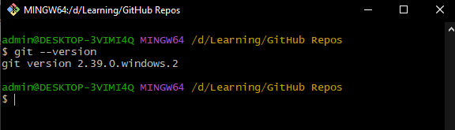
Version Checking

Slide 4
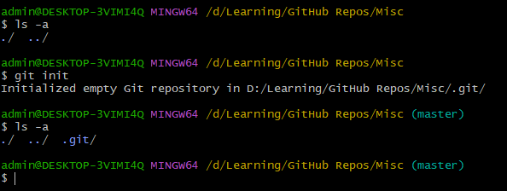

Creating .git folder on local machine
run $\$ git init$ command to create a .git folder inside the current working directory.

Slide 5

Configuring .git folder with credentials

Slide 6
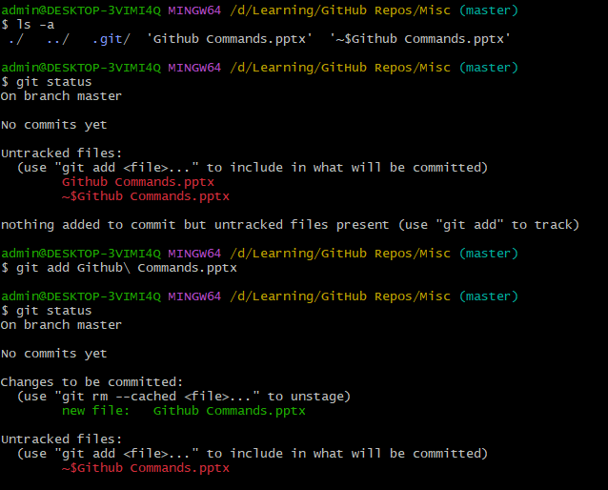
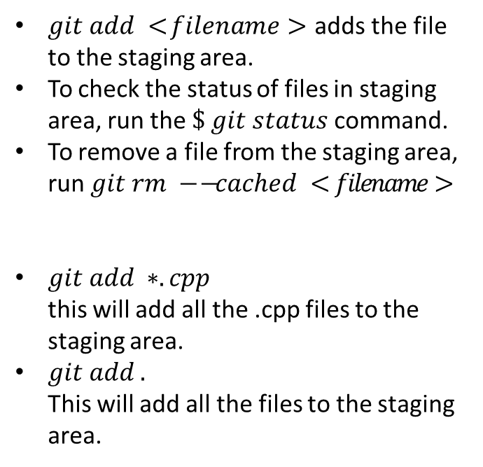
Add files to git
$git add <filename>$ adds the file to the staging area.
To check the status of files in staging area, run the $\$ git status$ command.
To remove a file from the staging area, run $git rm −−cached <filename>$
$git add ∗.cpp$ this will add all the .cpp files to the staging area.
$git add .$ This will add all the files to the staging area.

Slide 7
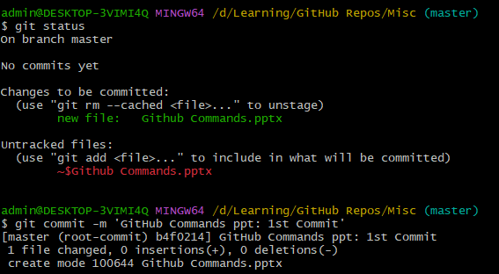
Committing file to git
Run $\$ git commit −m{}_{}^{′}{<o}ur message for commit>′$ to commit the file to git with the custom message.

Slide 8
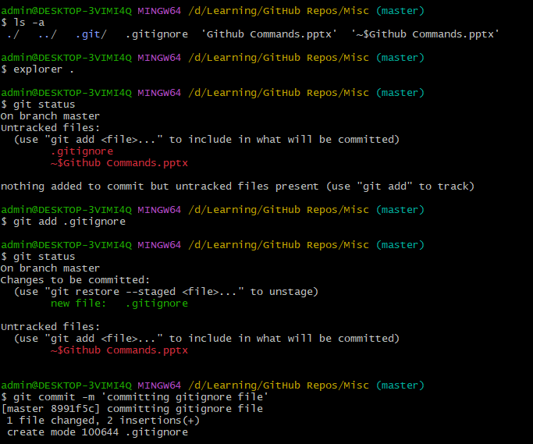
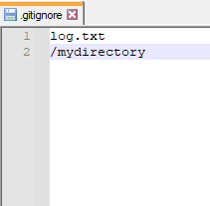
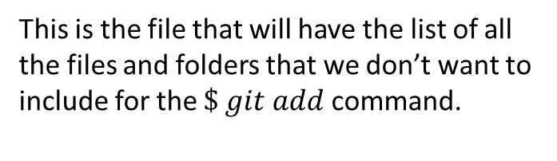
.gitignore file
This is the file that will have the list of all the files and folders that we don’t want to include for the $\$ git add$command.

Slide 9
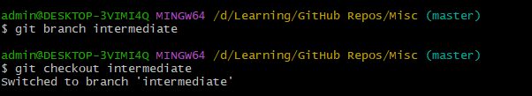
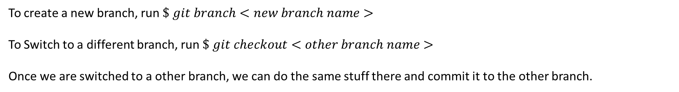
Creating a new branch (for commit)
To create a new branch, run $\$ git branch<new branch name>$
To Switch to a different branch, run $\$ git checkout<other branch name>$
Once we are switched to a other branch, we can do the same stuff there and commit it to the other branch.

Slide 10
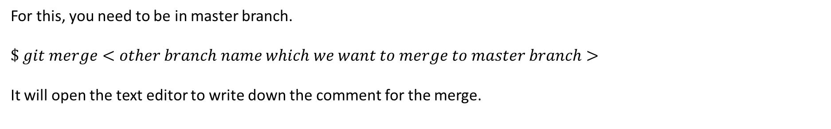
Merging other branch to master branch
For this, you need to be in master branch.
$$\$ git merge<other branch name which we want to merge to master branch>$$
It will open the text editor to write down the comment for the merge.

Slide 11

Connecting to a remote git host
Run $\$ git remote add<repo shortcut name> <repo url>$ to connect.
github_moon44

Slide 12
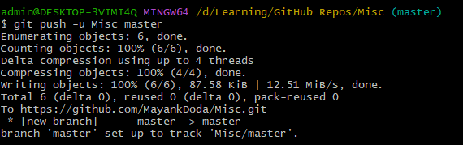
Push commit files to remote git host

